Slide 1

Comparative Analysis of Big Data Tools
GIRIJA RATHORE
2015016-CSE-CC-SEM-05

Slide 2

Beginner’s Guide to Big Data
Technological Buzzword
Humongous collection of data, growing at an exponential rate
Social Media, Music, Movies contribute to incredible growth in the amount of data

Slide 3
Beginner’s Guide to Big Data
Categories
Structured
(stored in an orderly fashion)
Unstructured
(lacks a standardized format)
Semi-Structured
(includes data with organizational properties)

Slide 4
Beginner’s Guide to Big Data
Characteristics
Volume
Velocity
Variety
Veracity
Value

Slide 5

Working with Big Data Tools
Concerned with storage issues of Big Data
Help with Data Collection and Extraction
Each different tool is designed to satisfy a set of needs

Slide 6
Problem Statement
To compare different Big Data visualization and analytics tools for beginners
To evaluate selected tools and recommend the best fit tool based on factors of comparison

Slide 7
Factors of Comparison
Usability & Availability
Visualization
Supported Algorithmic Options
Data Source Compatibility
Interface & Dashboards
User- Friendliness & Developer-Friendliness

Slide 8
Datasets Used
US Traffic Accident Dataset
(contains ID, Severity, Description, City, State, Visibility, etc. )
Titanic Disaster Dataset
(contains Chances of Survival, Class, Name, Gender, etc. )
Wine Quality Dataset
(contains Fixed Acidity, Citric Acid, pH, Quality Index, Sulphates, etc. )

Slide 9
Machine Learning: Savior for Big Data Visualization
Linear regression
Logistic regression
Statistical approach that models the relationship between input and output features
Input features: Independent variables
Output features: Dependent variables
Simple Linear Regression & Multivariable Linear Regression
Prediction of Petroleum Prices
Statistical approach that models the relationship between input and output features using Sigmoid Function
Maps any real value between 0 and 1
Binary (Pass/Fail), Multi ( Cats, Dogs and Sheep) and Ordinal (Low, Medium & High)
Predict whether a student passed or failed an exam

Slide 10
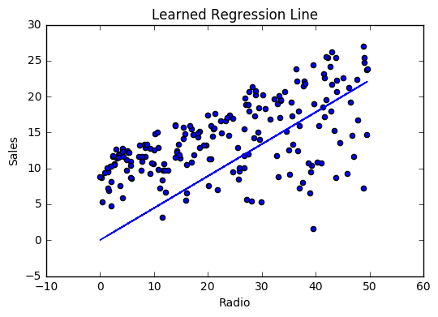
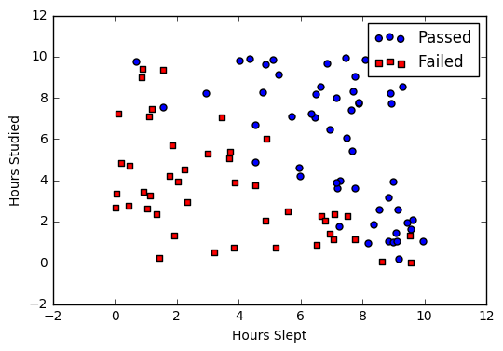
Machine Learning: Savior for Big Data Visualization
Linear regression
Logistic regression

Slide 11
Machine Learning: Savior for Big Data Visualization
Decision trees
Random forest
Algorithmic Approach that identifies ways to split a data set based on different conditions
Most widely used and practical
Mimics human tendency to deal with predictions
Decision Rules <> If-Else Statements
Choosing between various manufacturing items or investment options
Algorithm which contains a number of decision trees on various subsets of the given dataset and takes the average to improve the predictive accuracy
Greater the number of decision trees, greater is the accuracy and lower is the possibility of over-fitting.
Uses Bagging
Banking Loan Prediction

Slide 12
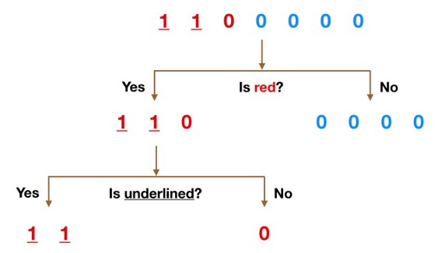
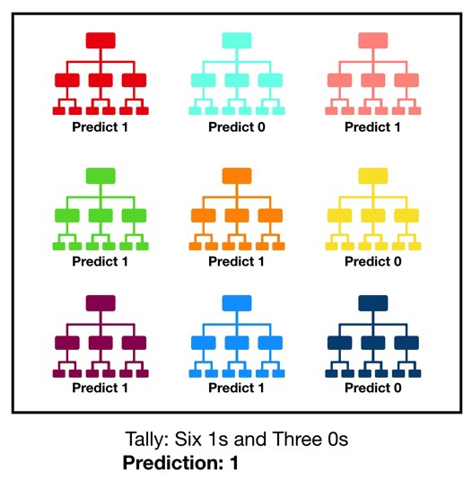
Machine Learning: Savior for Big Data Visualization
Decision trees
Random forest

Slide 13





Big Data Tools
Tableau
RapidMiner
Orange
Python

Slide 14

Tool 01: Tableau
Business Intelligence focused Data Visualization Software Tool
Founded in 2003
Supports various version : Tableau Desktop, Tableau Online, Tableau Prep, Tableau Server and Tableau Public
Works well with both, Windows and MacOS

Slide 15
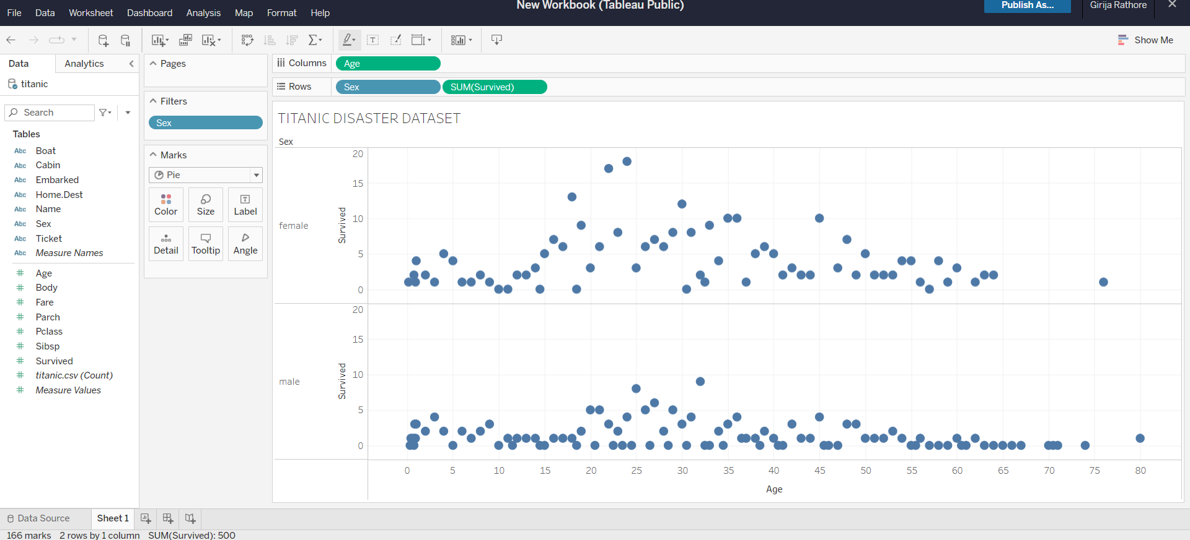
Interface

Slide 16
Tool 02: RapidMiner
Originally created as YALE, Yet Another Learning Environment in 2001
Covers all elements of the Machine Learning process including data preparation, results visualization and optimization
Has Corporate, Commercial as well as Research and Educational Applications

Slide 17
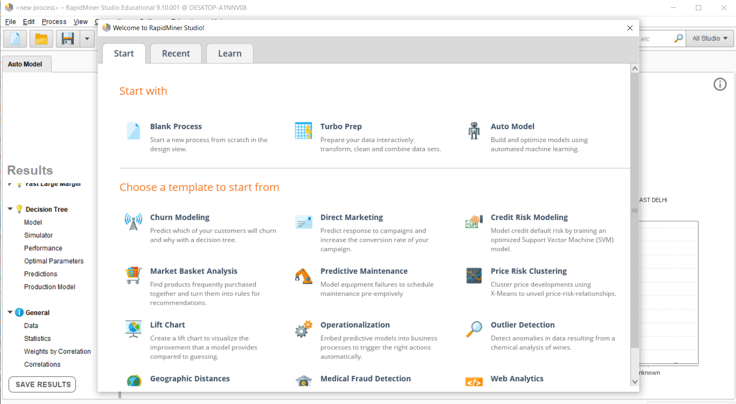
Interface

Slide 18

Tool 03: Orange
Data Mining and Visualization Tool founded in 1997
Supports a wide range of machine learning and data mining methods
Scriptable environment, a collection of python-based modules
Supported for all: Windows, Linux and MacOS

Slide 19
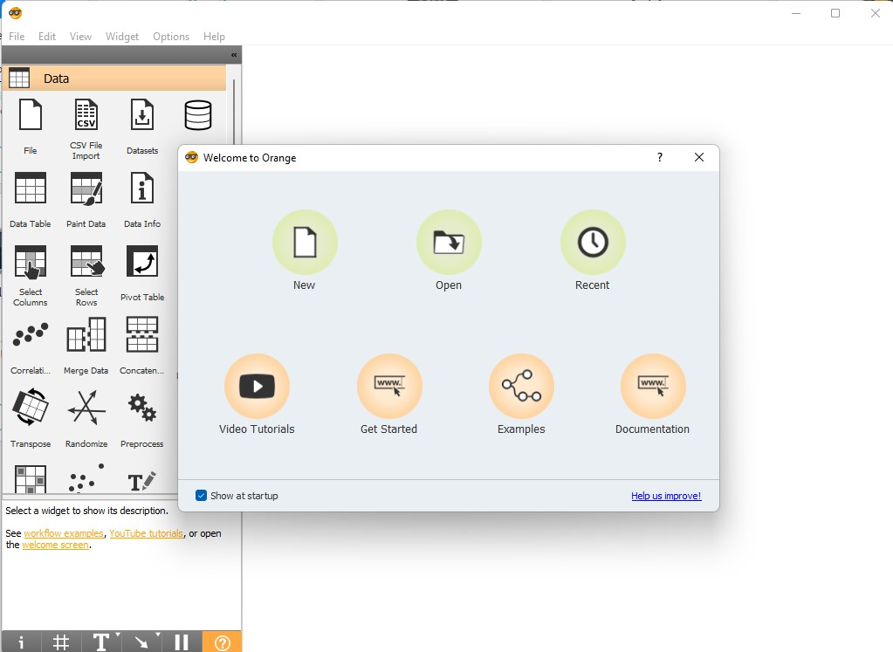
Interface

Slide 20

Tool 04: Python
High-level programming language initially designed in 1991, developed by Python Software Foundation
Easy coding, interpretation and evaluation
Two major versions: Python2 and Python 3

Slide 21
Libraries Used
Numpy
It is a math library to work with n-dimensional arrays in Python. It enables us to do computations effectively and efficiently.
Pandas
Pandas is a Python library used for working with data sets. It has functions for analysing, cleaning, exploring, and manipulating data.
SkLearn
It has most of the classification, regression, and clustering algorithms, and works with Python numerical libraries.
MatPlotLib
It is a trendy plotting package that provides 2D plotting as well as 3D plotting.

Slide 22
Comparative Analysis
Criterion of Analysis | Tableau | RapidMiner | Orange | Python
Usability & Availability | Simple to Use, Student License | Easy to Use, Student License | Interactive, Open-Source | Pre-requisites include Coding, Open Source
Visualization | Many Visualization Options | Comparatively Less Options | Interactive Visualization | Time Consuming Visualization using MatPlotLib
Data Source Compatibility | Supports any Dataset | Supports Small & Large Dataset | Supports Small Dataset efficiently | Supports any Dataset
Interfaces & Dashboards | GUI, Customized Dashboards | GUI, Customized Dashboards | GUI + CLI, Customized Dashboards | CLI, Complex Visualization Environment
User-Friendliness | Interactive | Simple, Easy to Learn | Simple, Easy to Learn | Requires Programming Language

Slide 23

Conclusions
“Big Data has the potential to revolutionize the way governments, corporations and academic institutions work.” -Susan Hauser, VP (Microsoft)
Big Data isn’t new, but it’s suddenly gaining reach, as more people digitalize their lives, thus requiring more efficient tools.

